Slide 1
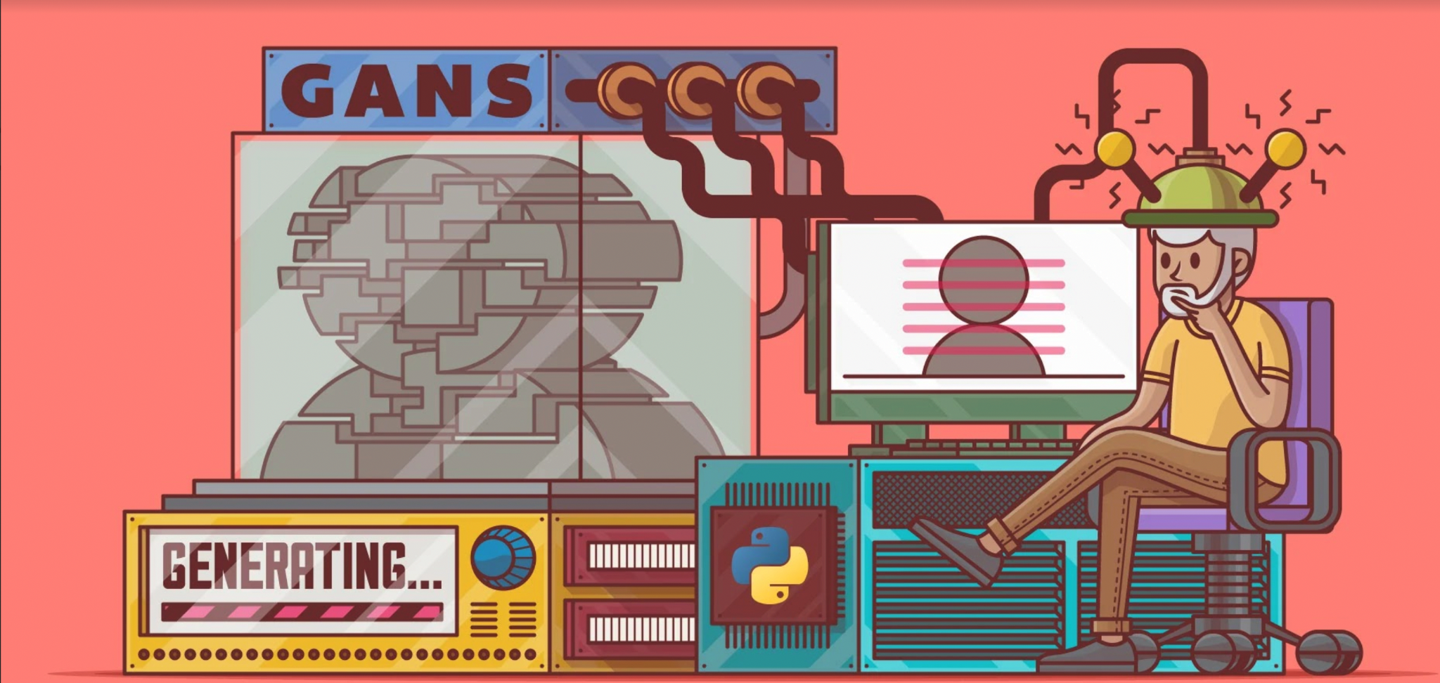
WEB IMPLEMENTATION OF GENERATIVE ADVERSARIAL NETWORKS
Done by
Dheeraj Perumandla (17311A1232)
Likhitha Alle (17311A1228)
Nikitha Katakam (17311A1215)
Internal Guide
Sreedhar Potla
Co-Ordinator
Dr. Sunil Bhutada

Slide 2
Sl. No. | Title
1 | Abstract
2 | Introduction
3 | Specifications 3.1 Hardware requirements 3.2 Software requirements
4 | Architectural design 4.1 UML diagram 4.2 Procedural steps
5 | Modules
6 | Implementation
7 | Sample code
8 | Results
9 | Conclusion and Future scope
10 | References

Slide 3
Abstract:
This Generative Adversarial Network is designed for attention-driven, multi-stage refinement for fine-grained text-to-image (Bird Image) generation based on the captions given by the user.
Automatically generating images according to natural language descriptions is a fundamental problem in many applications, such as art generation and computer-aided design. It also drives research progress in multimodal learning and inference across vision and language, which is one of the most active research areas in recent years.

Slide 4
Introduction:
Automatically generating images according to natural language descriptions is a fundamental problem in many applications, such as art generation and computer-aided design. It also drives research progress in multimodal learning and inference across vision and language, which is one of the most active research areas in recent years.
In many fields, like computer vision and natural language processing, the need of data is very crucial, but every time the data might not be in large size.
In this scenario, GANs come into play. They generate data.

Slide 5
Specifications:
Software: 1. React JS
2. Python 3.x
Hardware: 1. Nvidia GPU (>=4GB) (Compulsory as the program needs CUDA)
2. RAM >= 8GB

Slide 6
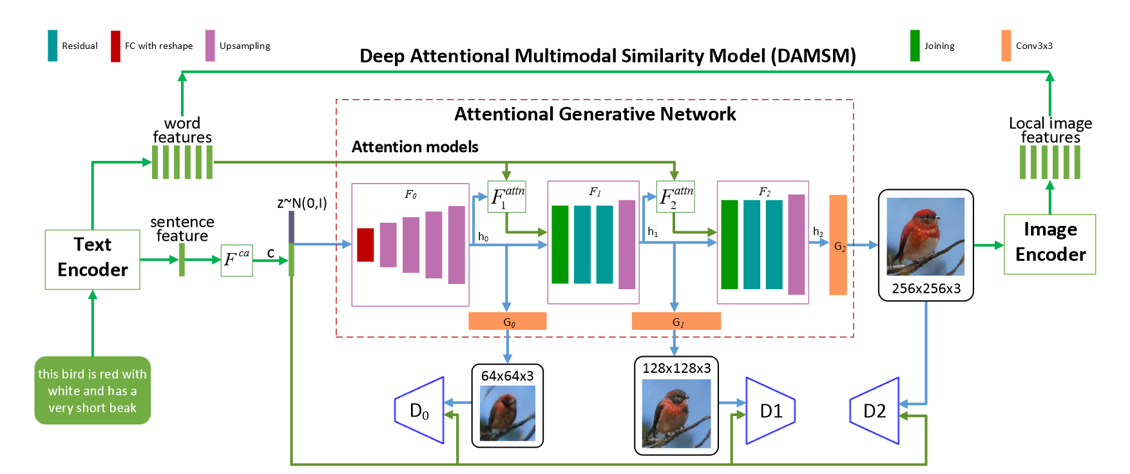
Architectural design:

Slide 7
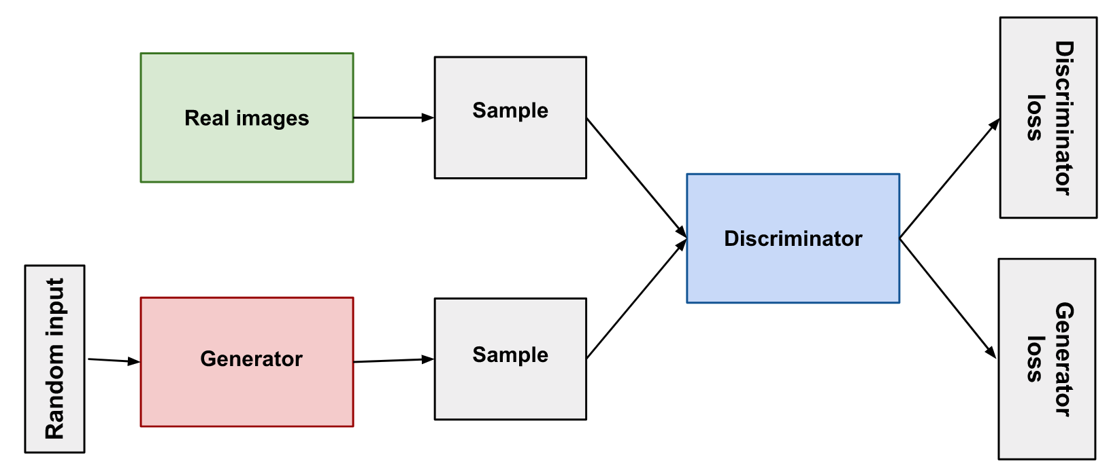
GENERATOR:
The generator part of a GAN learns to create fake data by incorporating feedback from the discriminator. It learns to make the discriminator classify its output as real.

Slide 8
DISCRIMINATOR
The discriminator in a GAN is simply a classifier. It tries to distinguish real data from the data created by the generator. It could use any network architecture appropriate to the type of data it's classifying.
The discriminator’s training data comes from two sources:
Real data instances, such as real pictures of people. The discriminator uses these instances as positive examples during training.
Fake data instances created by the generator. The discriminator uses these instances as negative examples during training.

Slide 9
TEXT EMBEDDER(SKIP-THOUGHTS):
The Skip-Thoughts model is a sentence encoder. It learns to encode input sentences into a fixed-dimensional vector representation.
A trained Skip-Thoughts model will encode similar sentences nearby each other in the embedding vector space.

Slide 10
React JS:
React is an open-source JavaScript library for building user interfaces or
UI components.
React is only concerned with rendering data to the DOM, and so creating React applications usually requires the use of additional libraries for state management and routing.

Slide 11
Modules:
Front-End Modules:
Welcome Page
Input Page
Output Page
Datasets: Caltech-UCSD Birds-200-2011, Oxford-102
Back-End Modules:
Main.py (for backend running)
Datasets.py (for accessing dataset and preprocessing)
Training.py (for training the model)
Model.py (Accessing the model)
Pretrain.py (to used already saved models)

Slide 12
Implementation:
Use command “npm start” to start the front end server
Run app.py to start the backend server.

Slide 13
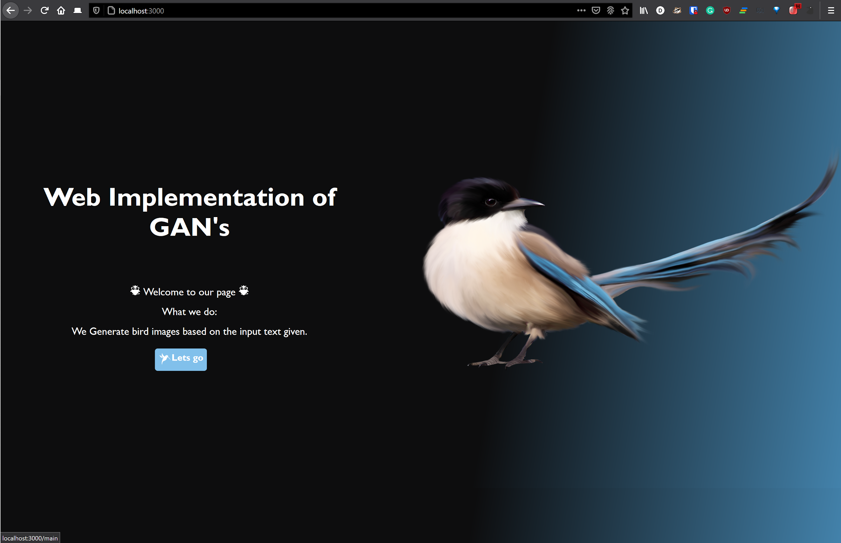
Front-end look: 1. Home Page

Slide 14
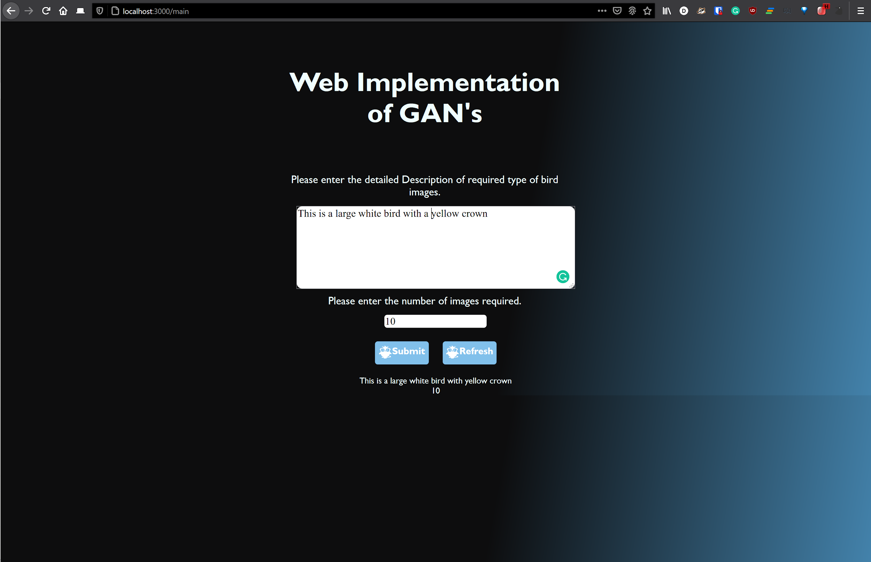
2. Input Page:

Slide 15
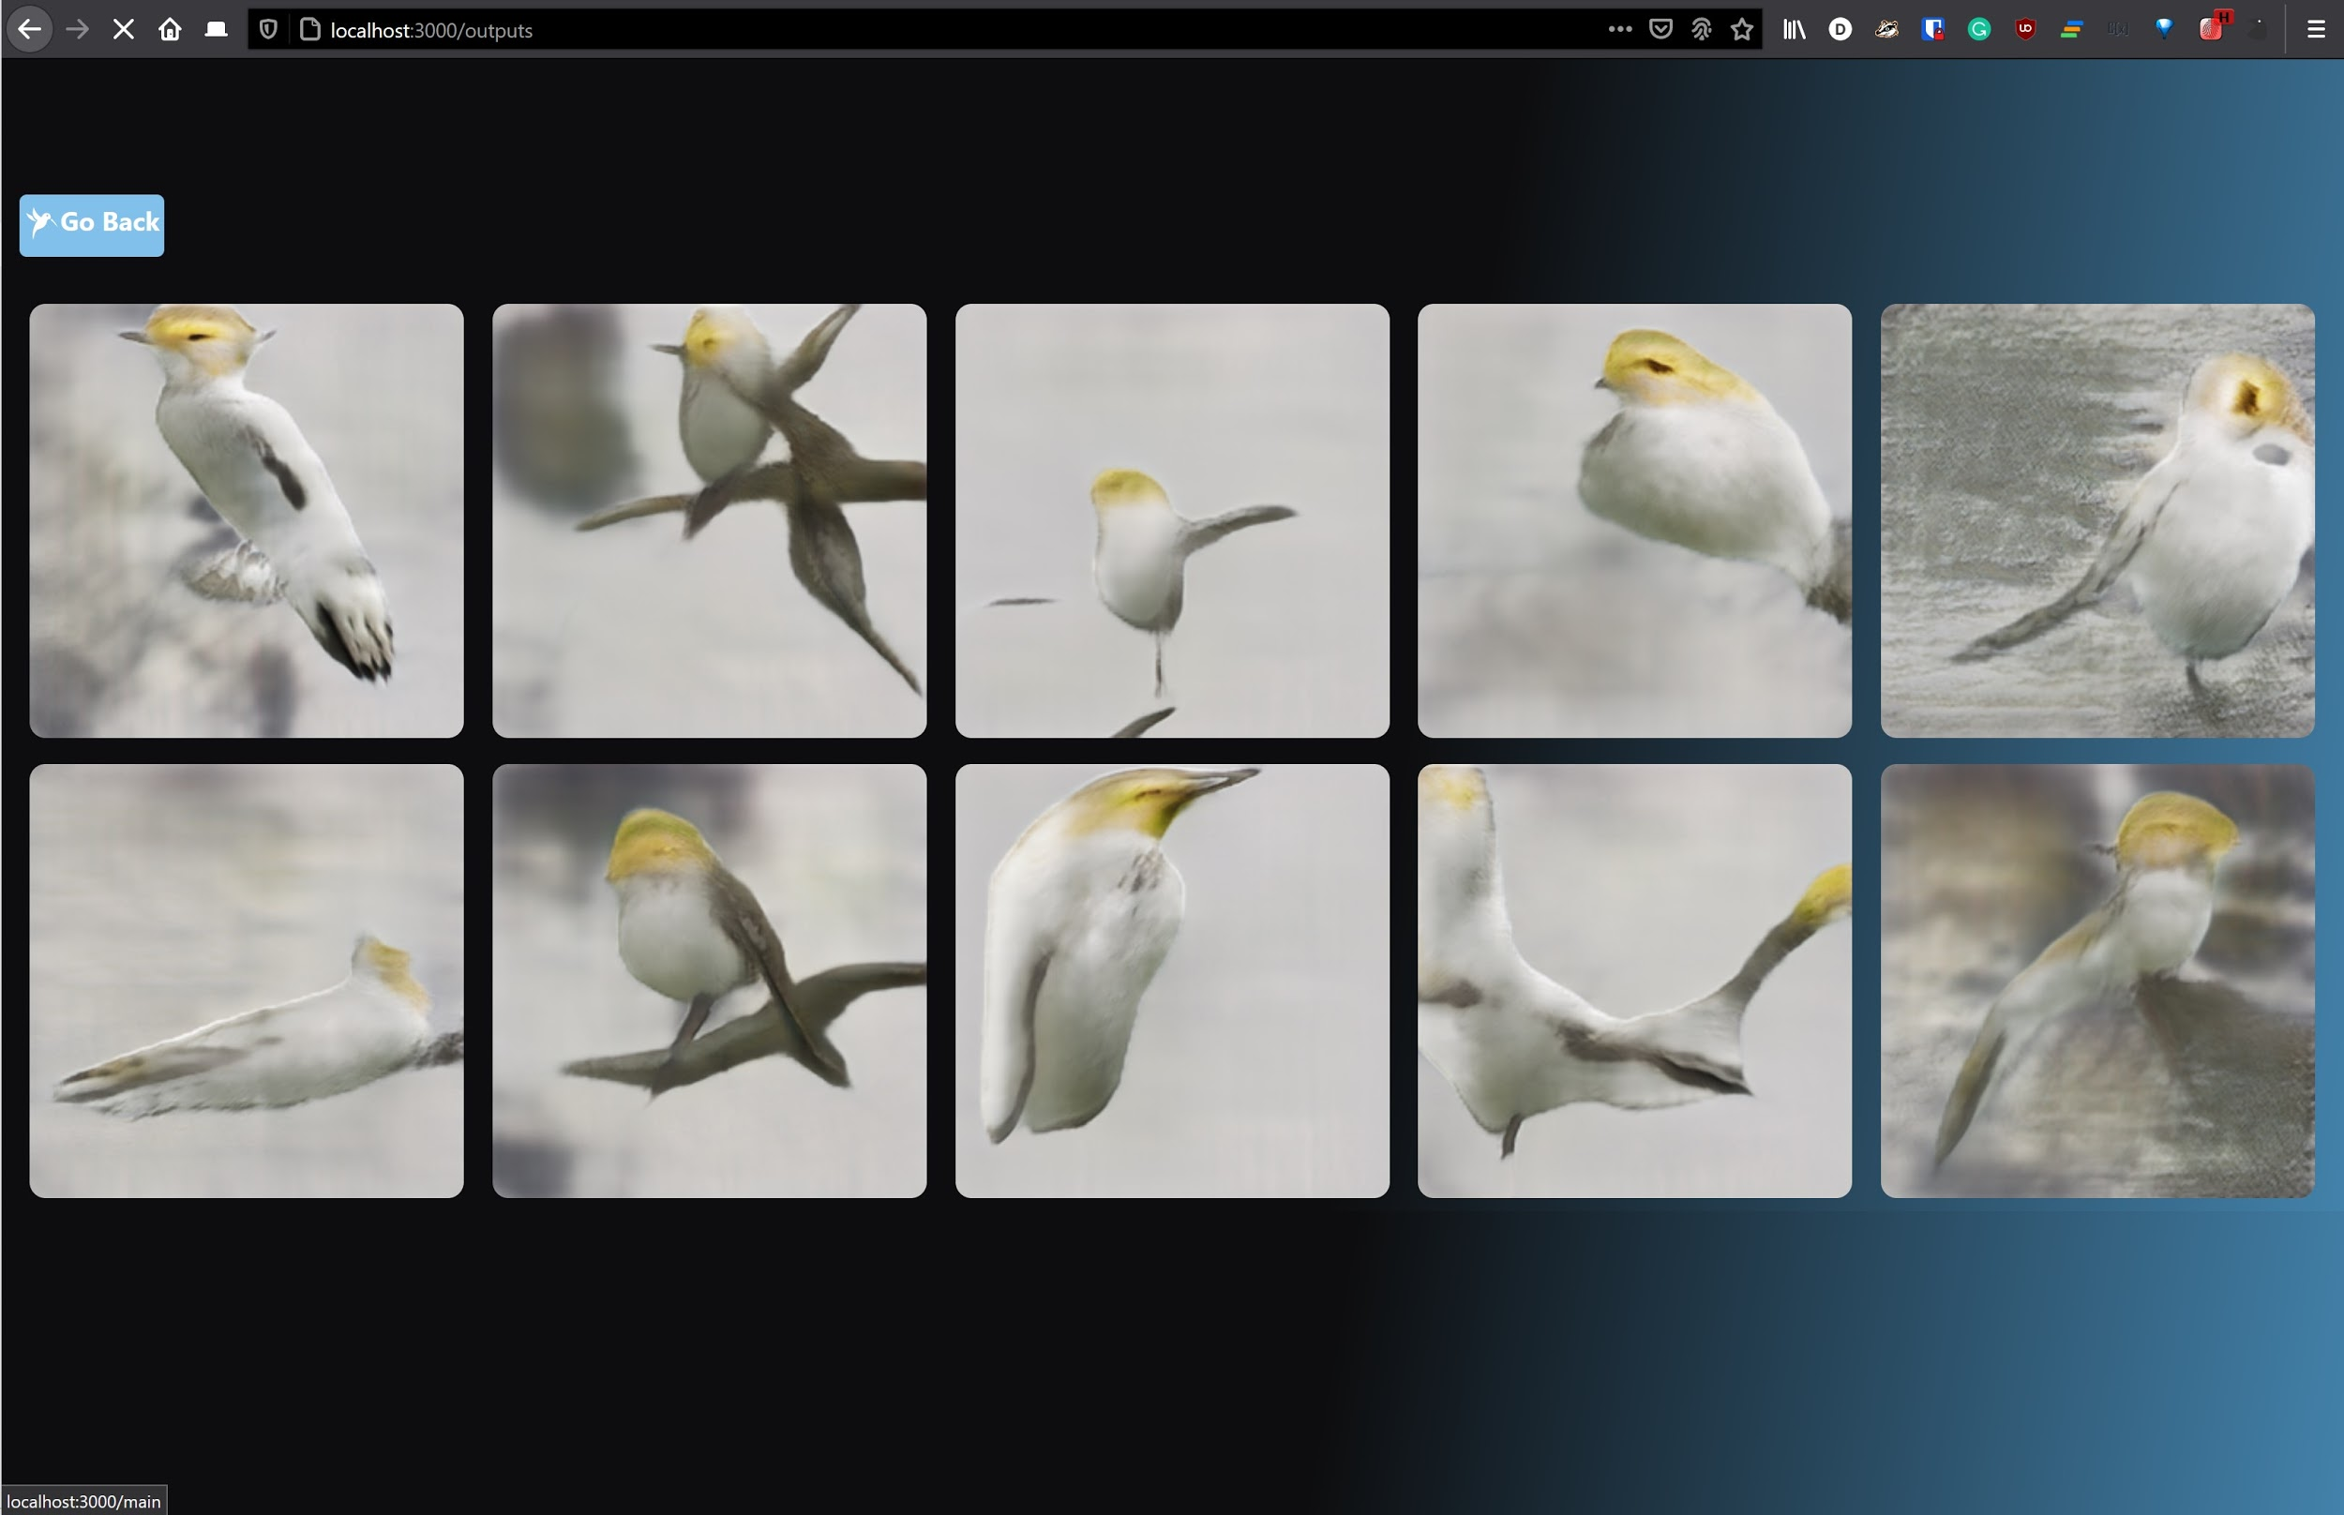
3. Output Page:

Slide 16
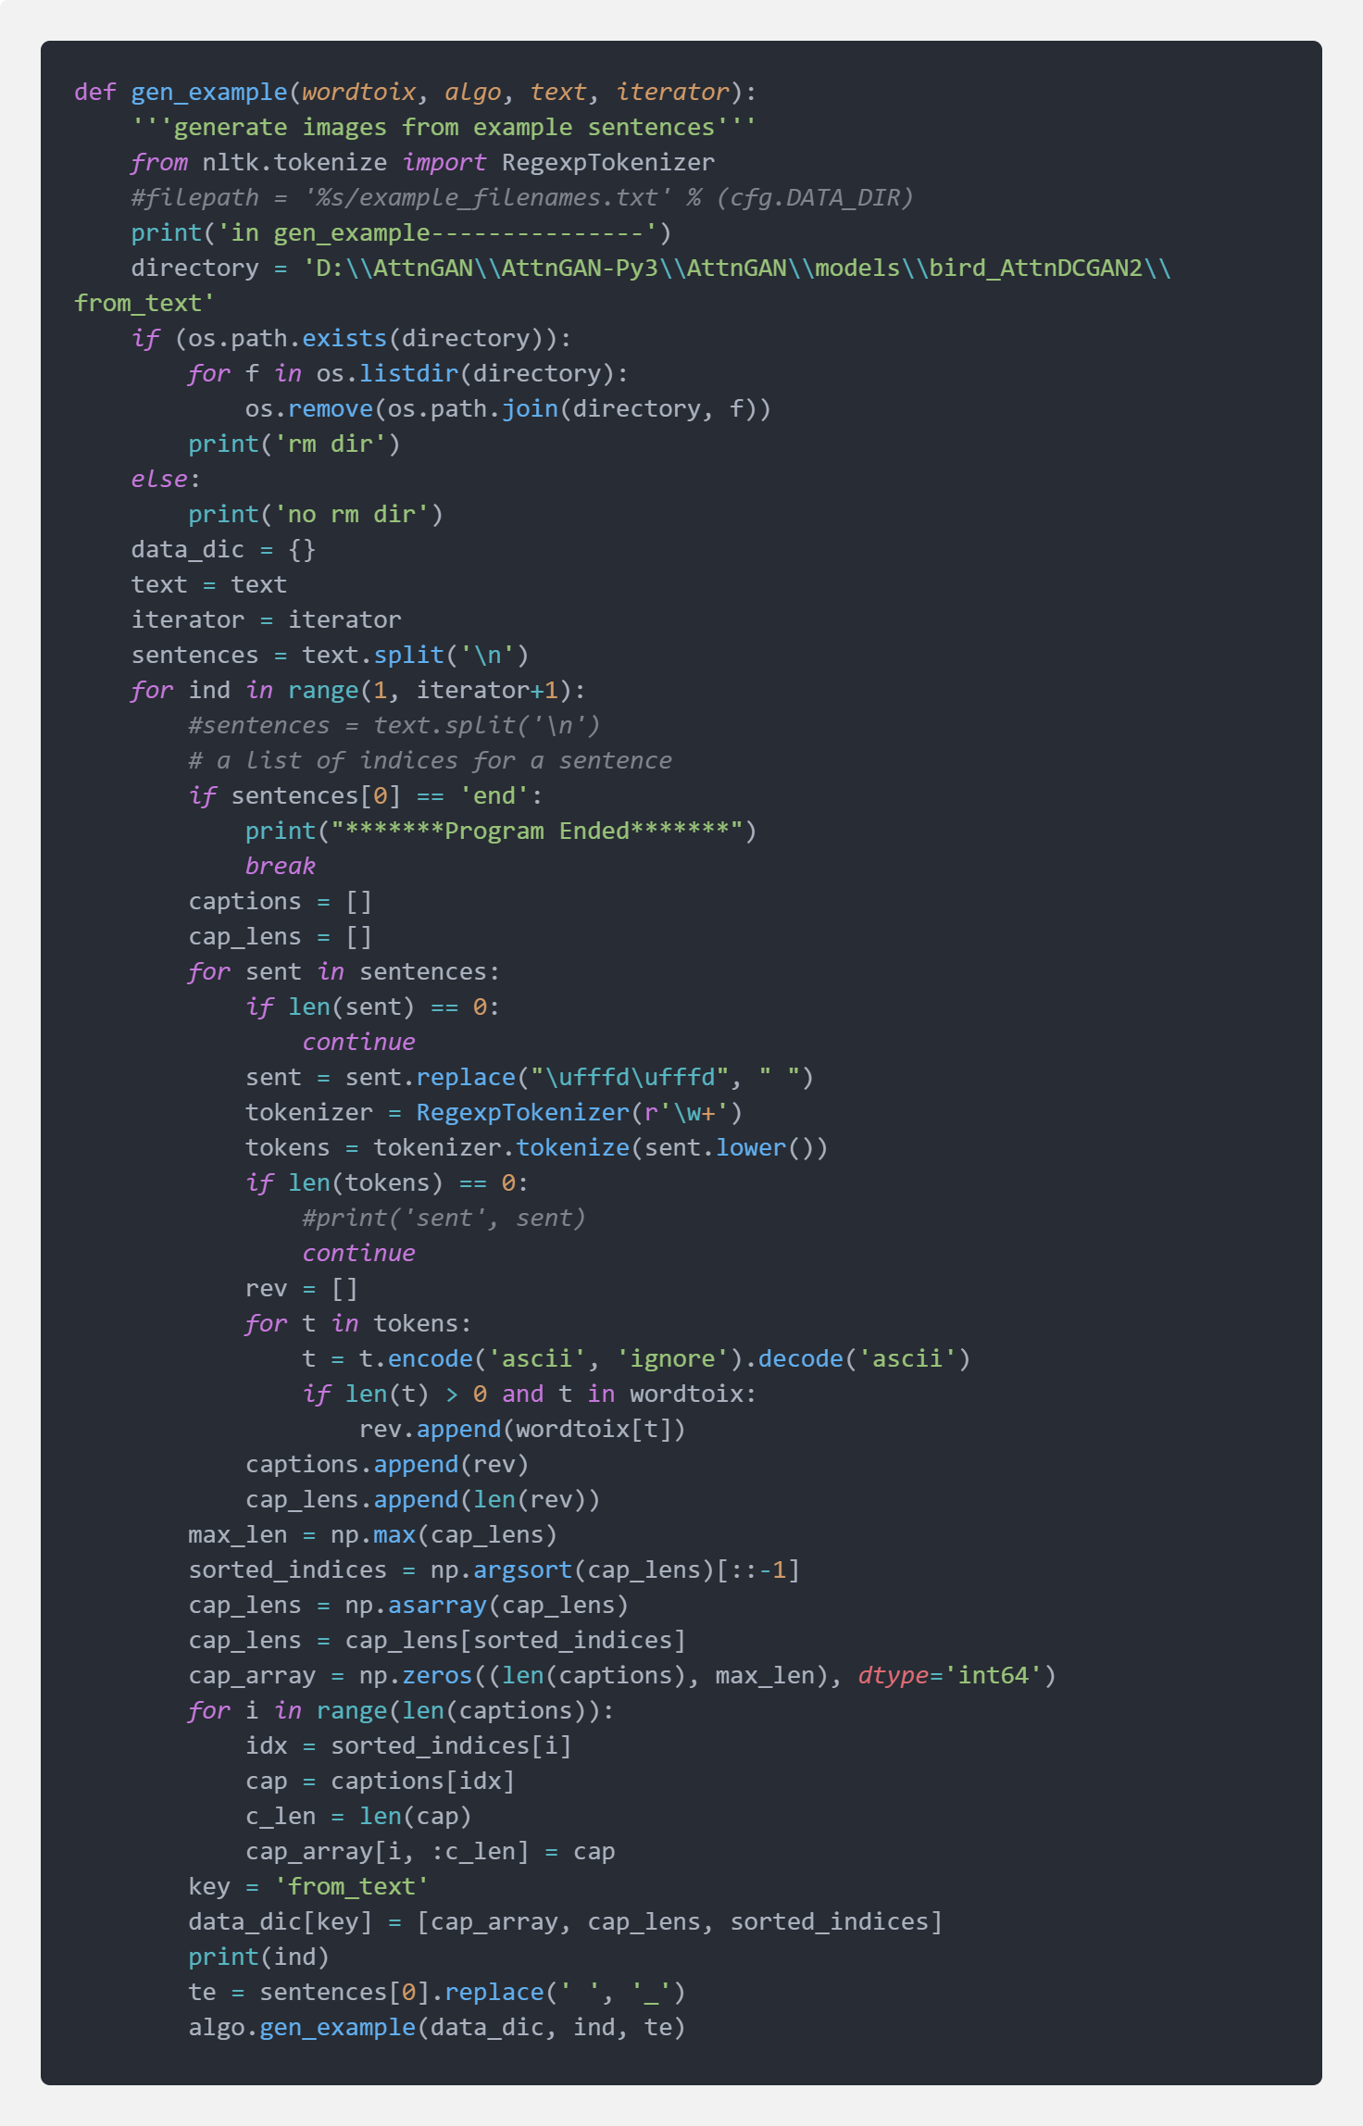
Sample code:

Slide 17
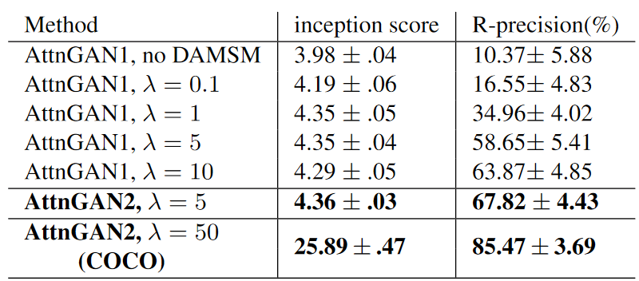
Results:

Slide 18
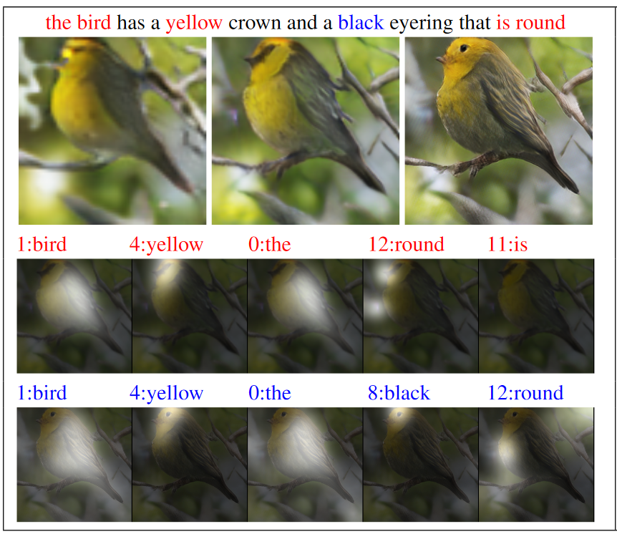

Slide 19
Conclusion and Future Scope:
Our model generates images based on input captions with a inception score of 4.36±.03 on CUB dataset and 25.89±.47 on COCO dataset.
Future Scope: The inception score can be further improved in the future

Slide 20
References:
[1612.03242] StackGAN: Text to Photo-realistic Image Synthesis with Stacked Generative Adversarial Networks
The Generator | Generative Adversarial Networks
Generative Models

